Slide 1
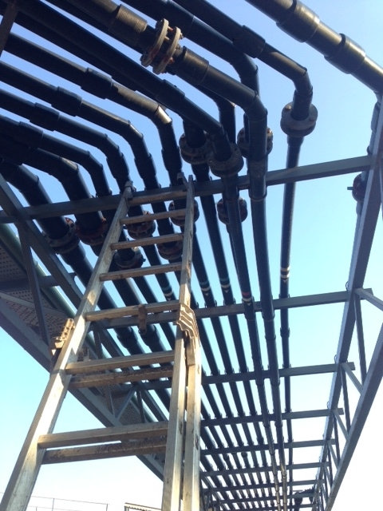
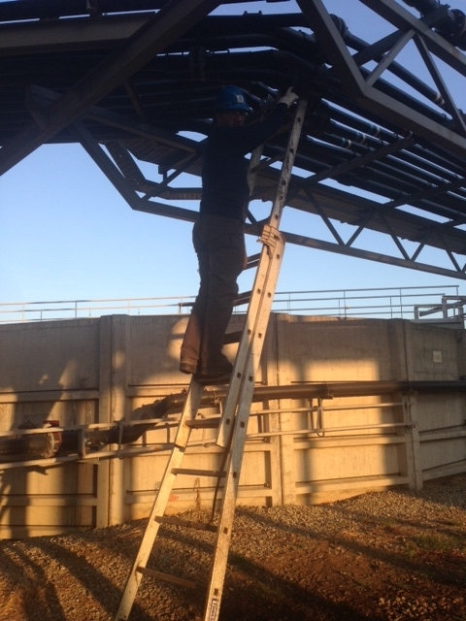
HS&E INCIDENT BULLETIN |  | 3rd Quarter 2013
Catalonia, Spain | Fall from Height – Wrist Fracture, Forehead Stitches
Summary:
Employee was using ladder to check what tool was needed to close a flange that was previously opened due to a blockage in the pipe. The ladder, supported on the flotation pipes, fell to the ground with employee on it. The worker fell from a height of 1.70 meters.
Root Causes: | Actions Taken Thus Far: Next Steps
the ladder was not properly fastened in order to ensure its stability | Communicate to employees the need to ensure proper support for ladders *Investigation not complete

